Slide 1

Introduction to
Programming, AI & DS

Slide 2




Requirements
C Programming
General-purpose computer programming language
Python
Open source programming Language
GitHub
Cloud based version control software using Git
LinkedIn
Professional Social Media

Slide 3



Integrated Development Environment & Code Editors
IDEs are a robust set of tools that are made to make programming as easy as possible.
Ex: Pycharm, VS Code
A code editor is a text editor with syntax highlighting, with basic text editing functionalities
Ex: Gedit, Notepad
Online: Programiz, OnlineGDB

Slide 4
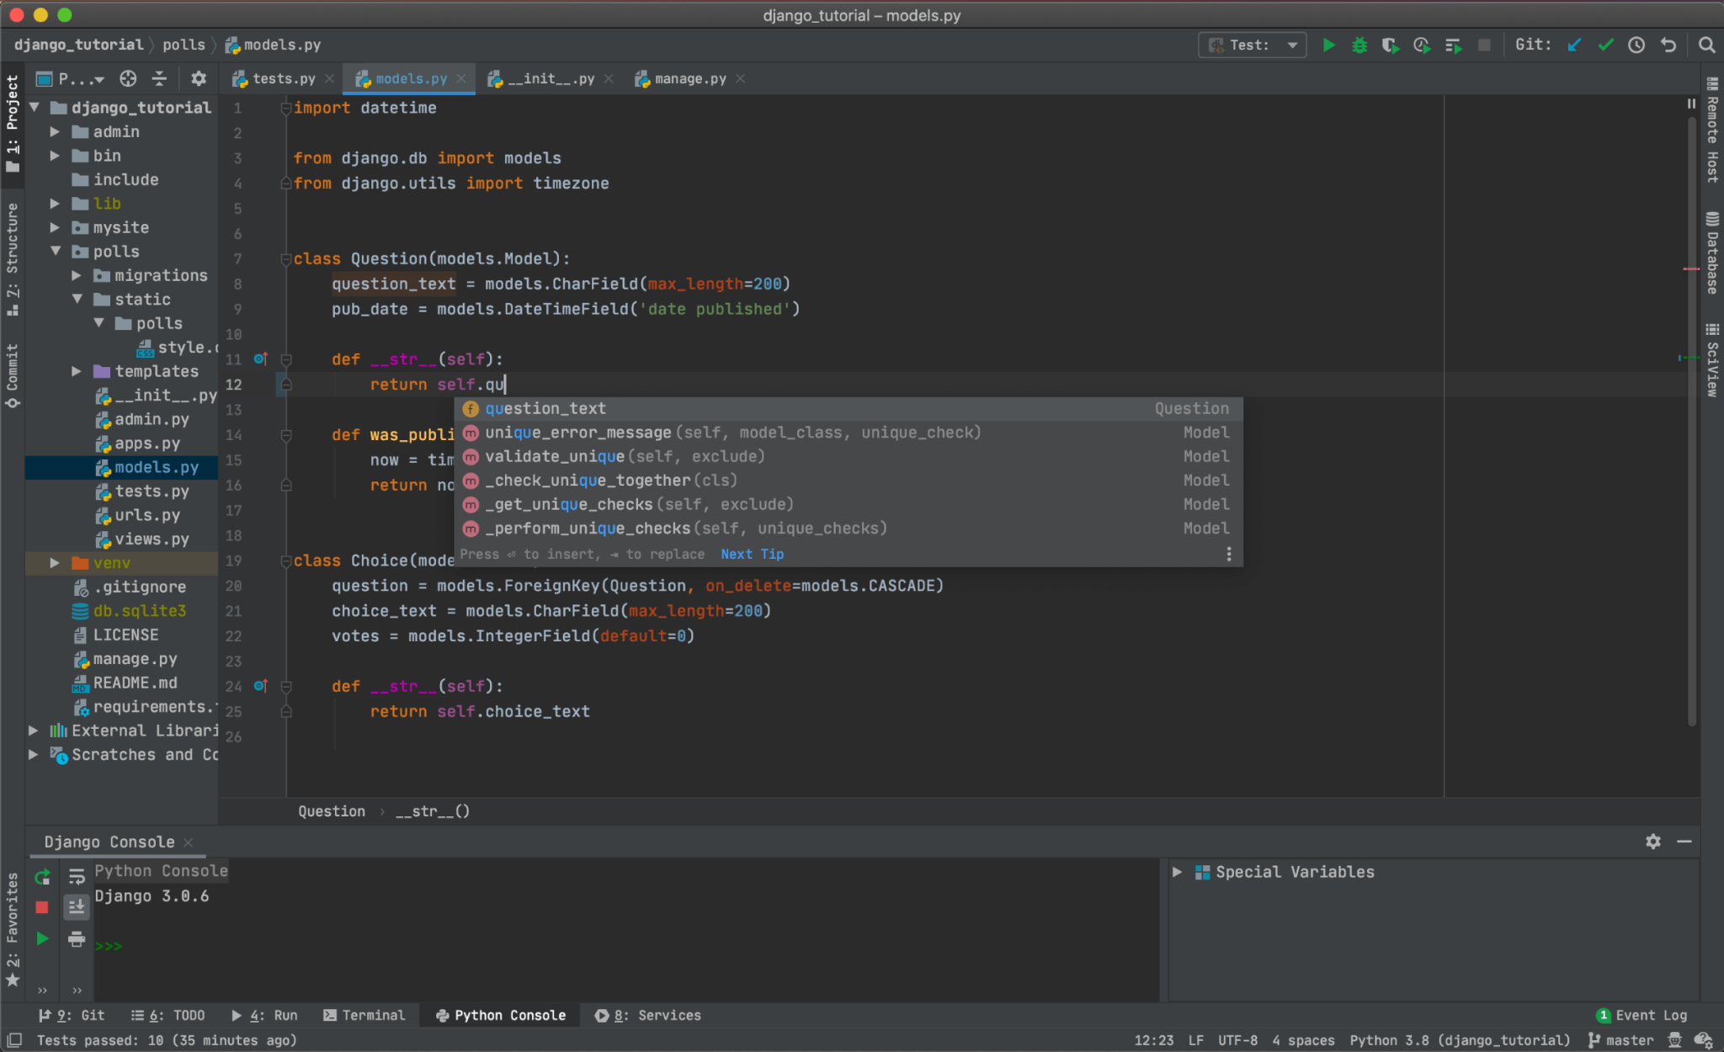
Pycharm

Slide 5
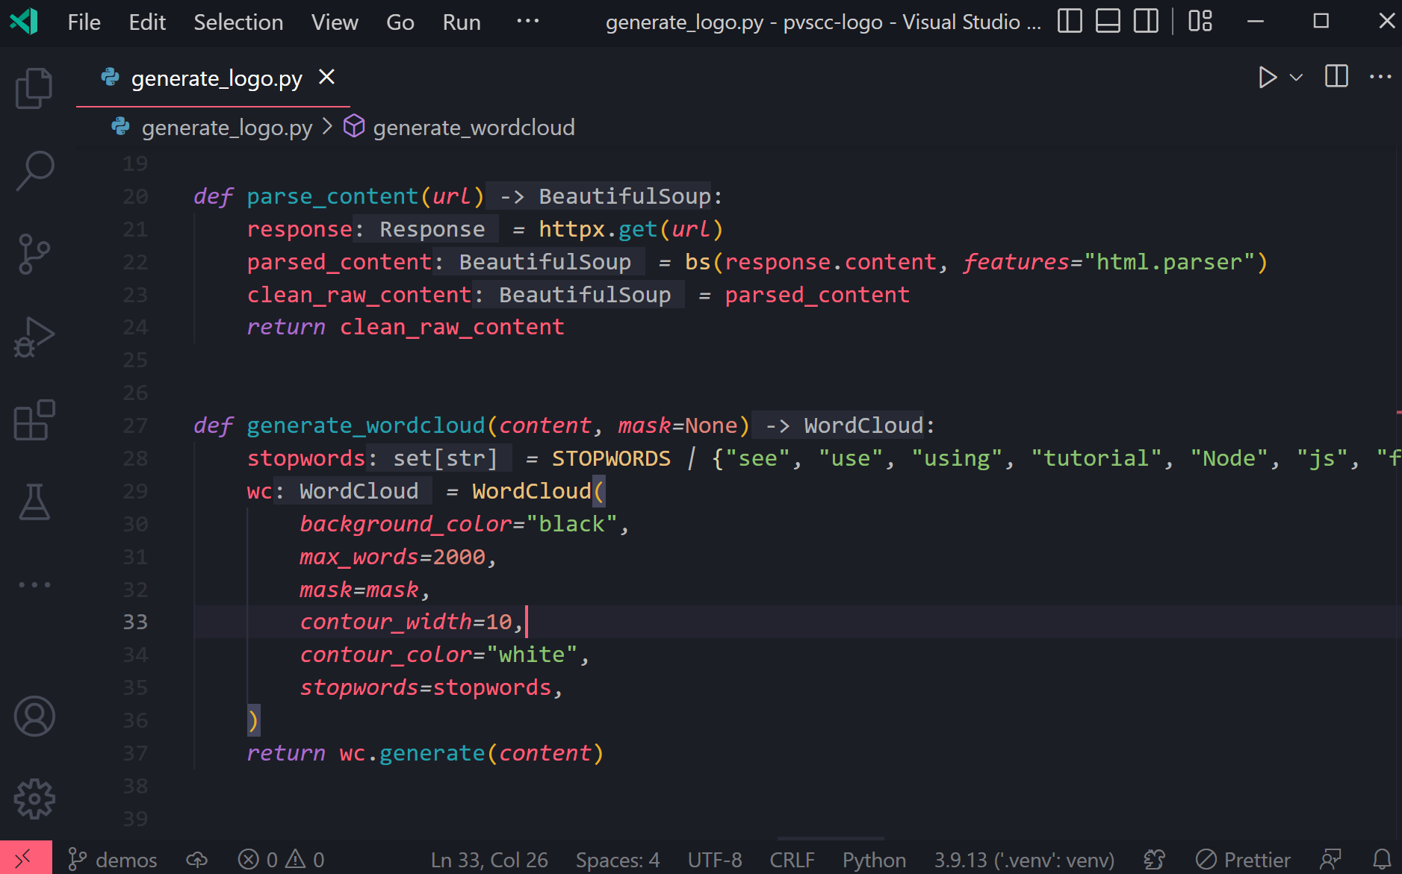
VS Code

Slide 6
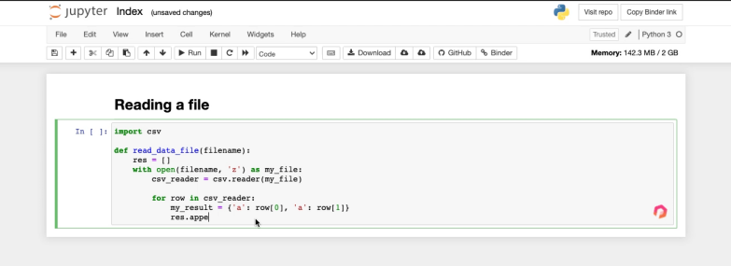

Jupyter Notebook

Slide 7
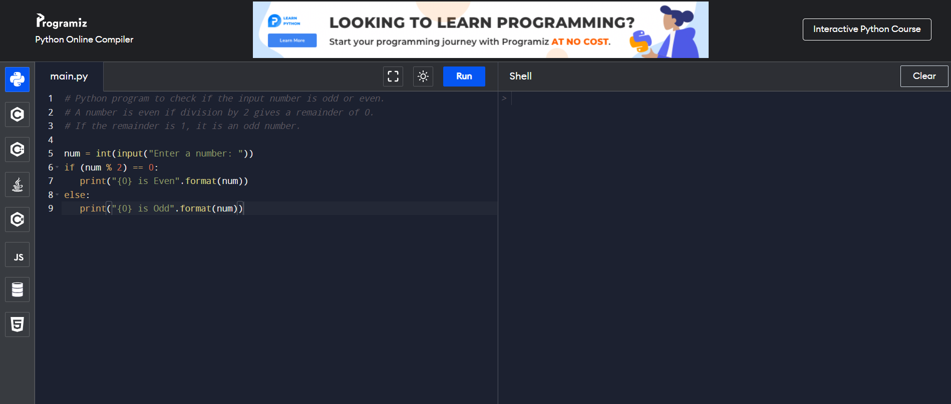
Programiz Online Text Editor

Slide 8
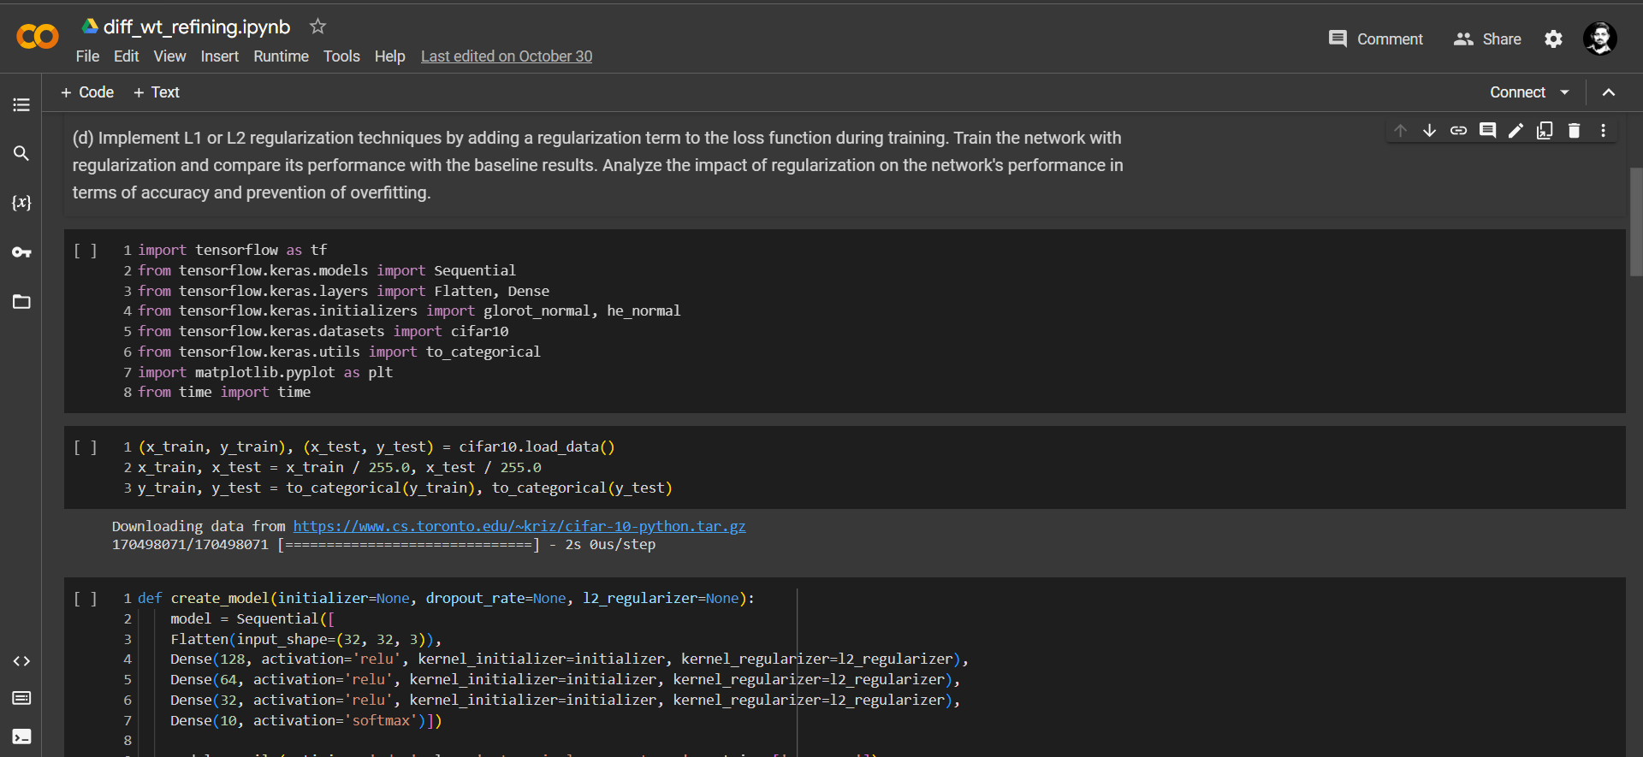

Google Colaboratory (Colab)
CPU, GPU, TPU etc… are available for free

Slide 9

Software
Anaconda
Recommended for beginners, fast systems
Install more packages than needed
Simple installation
GUI
Python
Option to install what is needed
Highly Recommended for old or slow systems
Need to study more about installation
May cause errors

Slide 10



Error Detection and Correction
Search on GOOGLE
IndentationError: expected an indented block
SyntaxError: invalid syntax
TypeError: 'list' object is not callable
NameError: name 'x1' is not defined
ImportError: cannot import name 'gTTS' from 'gtts'

Slide 11
AI & DS

Slide 12
Why AI & DS
AI - To make our lives easier
Going through books → Surfing on Internet → Asking Alexa/ChatGPT/Bard
DS - Make use of Real time ‘Big Data’
Doubt clearance about Puma shoes → Instagram → Amazon ads

Slide 13
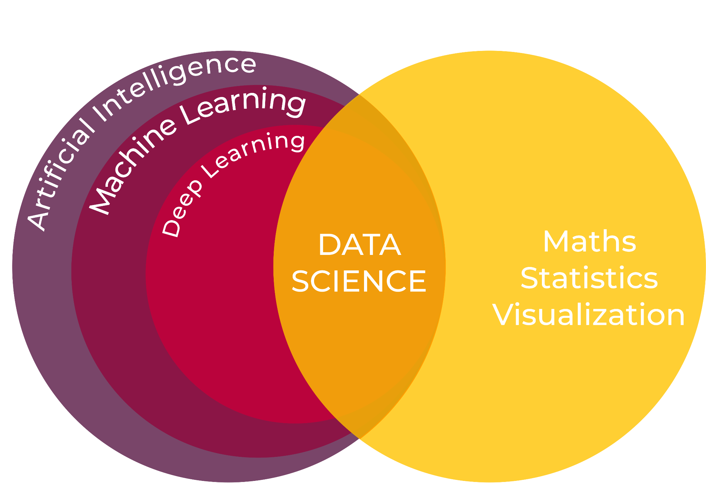

Slide 14
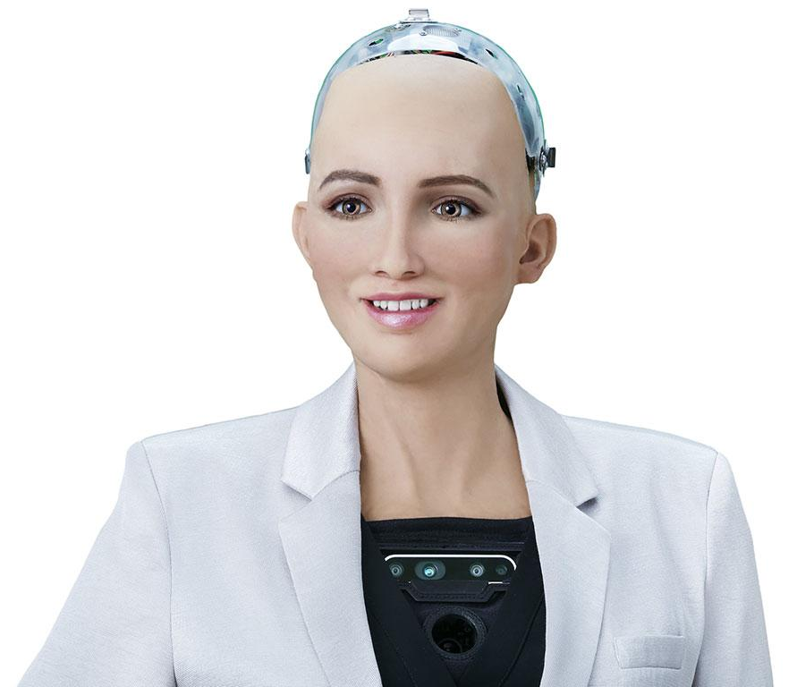
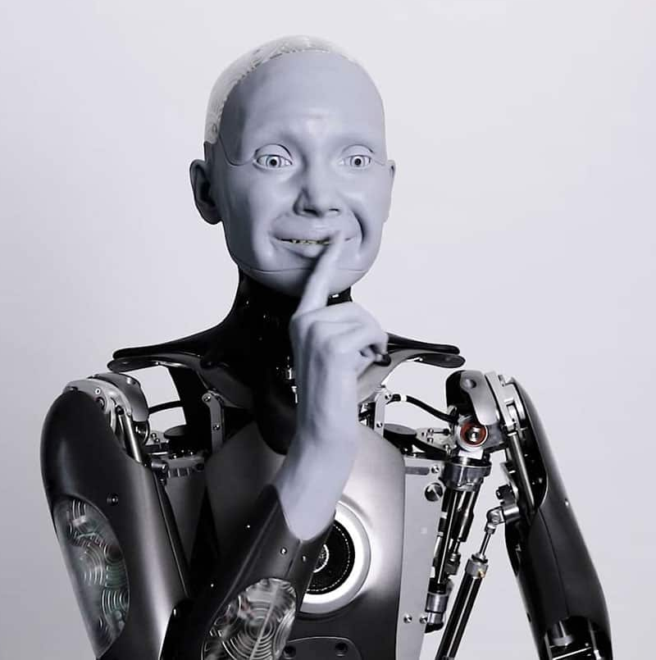

Slide 15
SOPHIA
AMECA

Slide 16
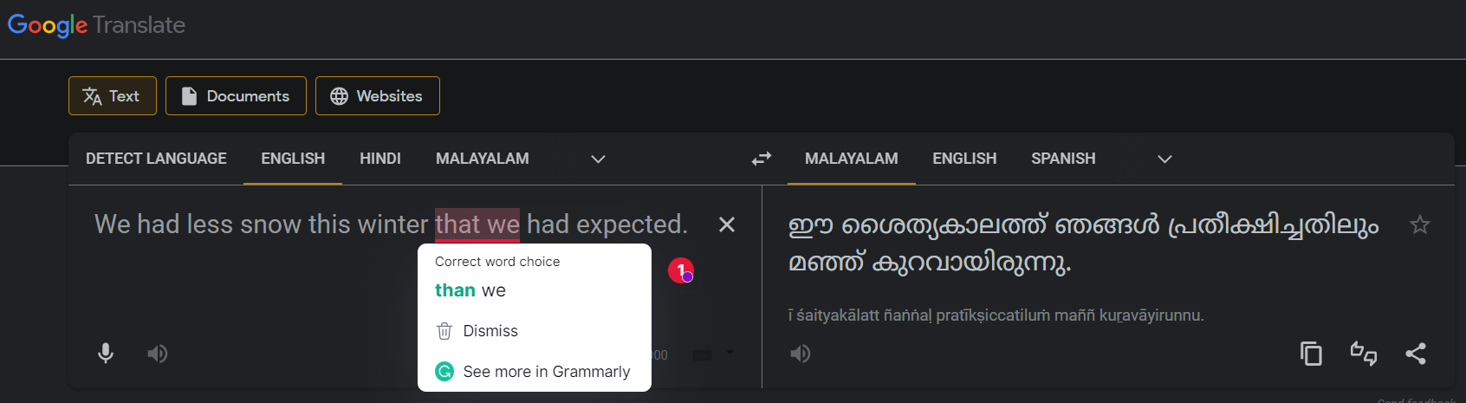
GRAMMARLY

Slide 17
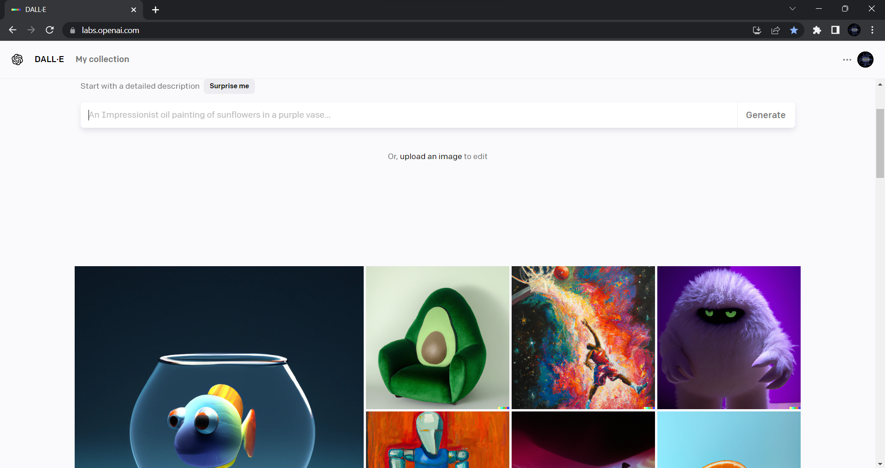
DALL•E 2

Slide 18


Slide 19
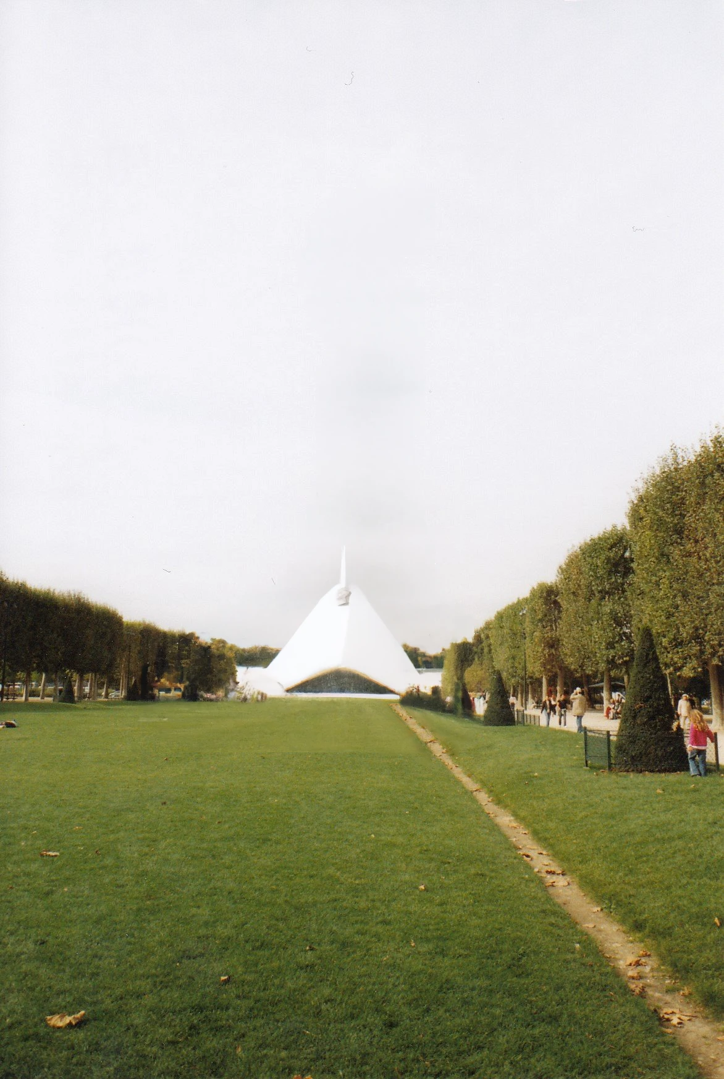
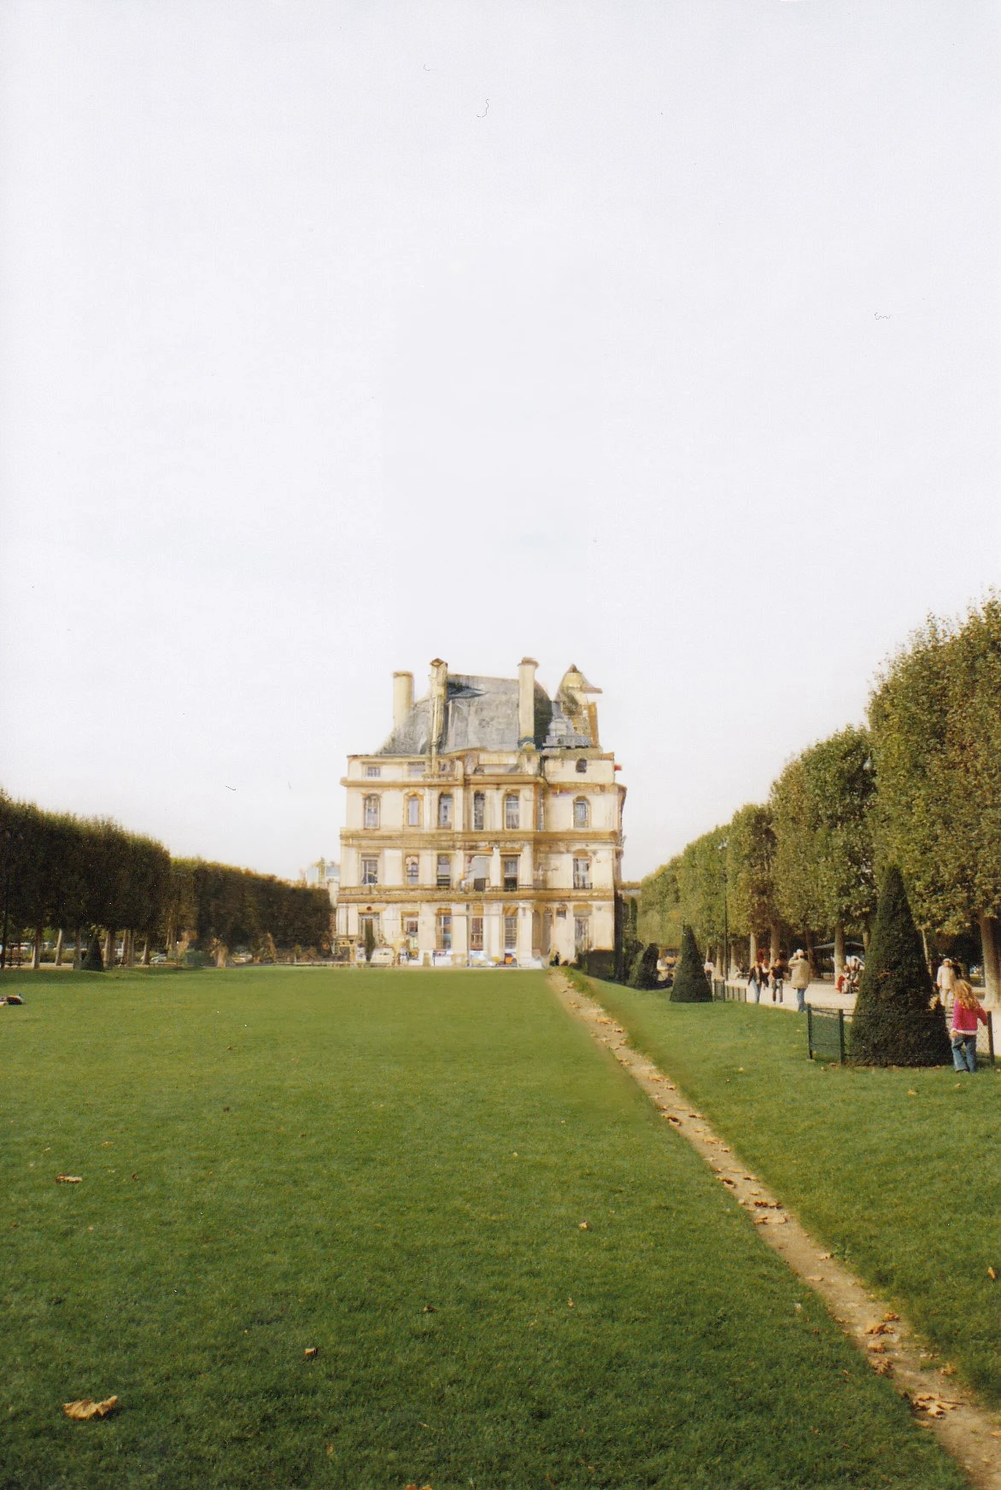
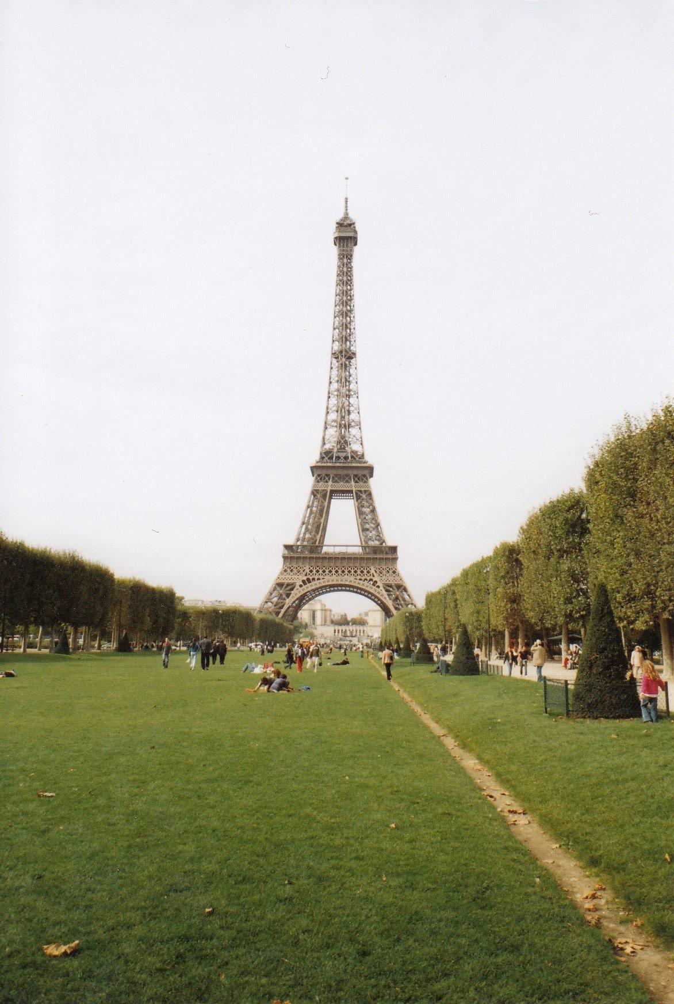

Slide 20
EDITED
EDITED
ORIGINAL

Slide 21
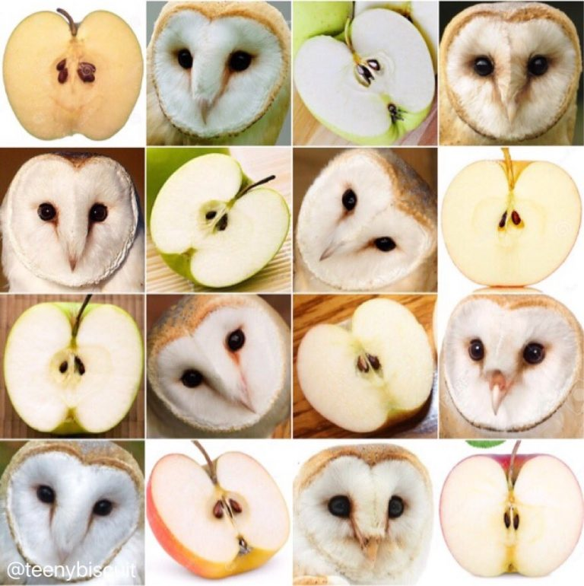
Need more fun?
A challenge in
AI ML DL

Slide 22
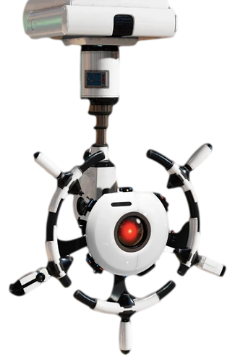
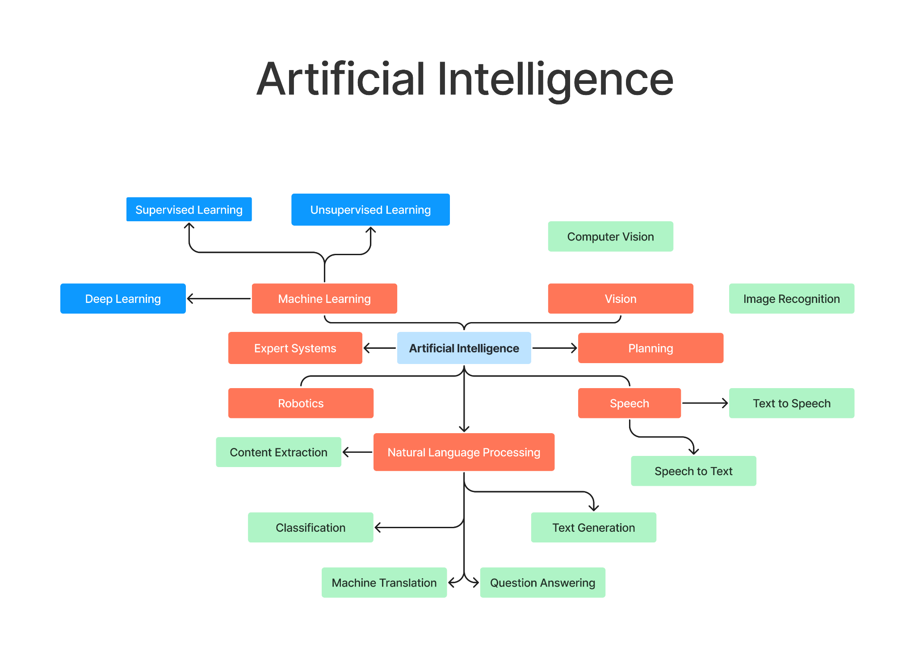

Slide 23
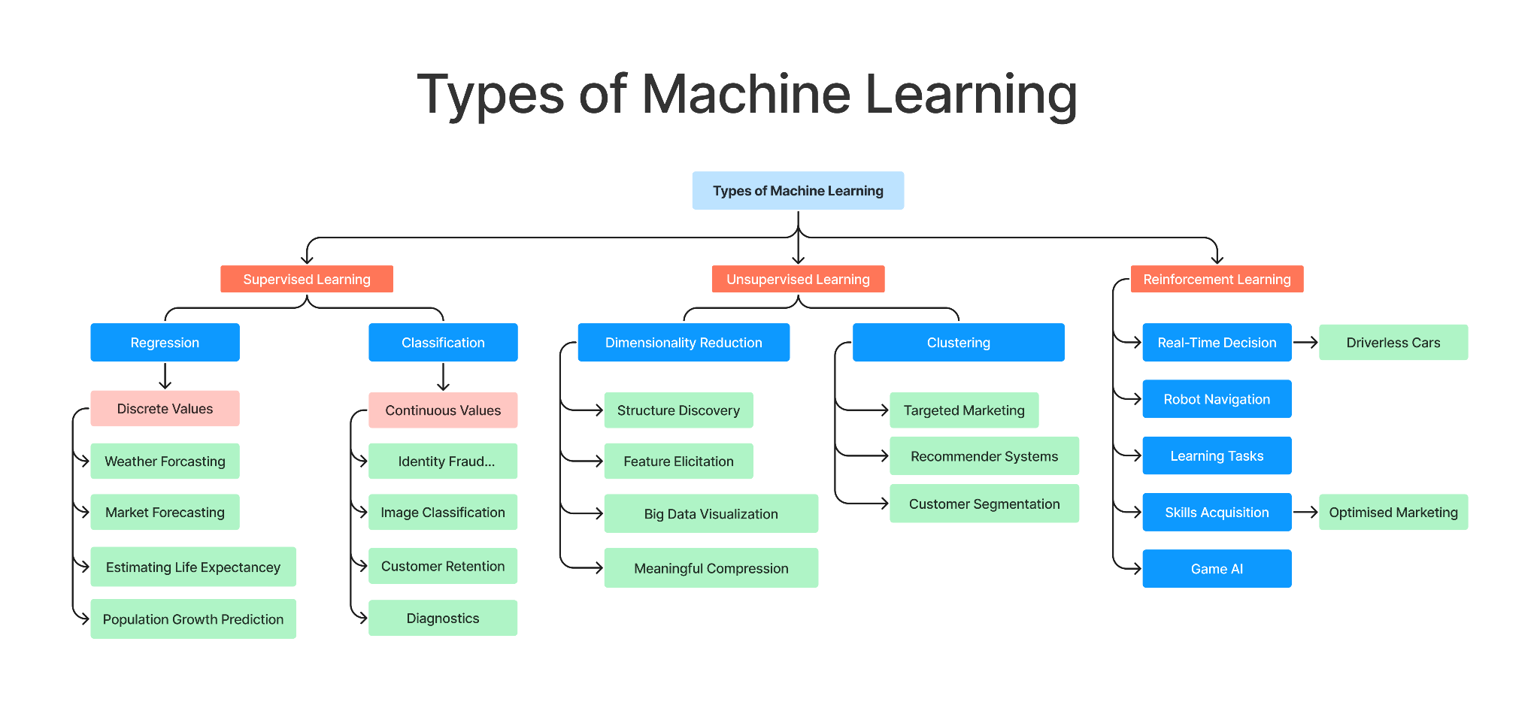

Slide 24
THANK YOU
Concept & Slides By,
Ajay T Shaju
S7 | AD

Slide 26
Google Colaboratory
C Programming language
Python Programming language
GitHub
Linkedin
IDEs
Code Editors
Online Code Editors
Pycharm
VS Code
Jupyter Notebook
Programiz
Anaconda program
Stack Overflow
Quora
Geeks for Geeks
W3schools
Artificial Intelligence
Machine Learning
Deep Learning
Data Science
Big Data
Types of AI
DALL.E 2
Grammarly
Word Tunes
Sophia Robot
Ameca Robot
thispersondoesnotexist.com
Challenges in ML
Types of ML
AI & Related fields
WEBSITES
DALL·E 2 Website: openai.com/dall-e-2
Intro to Images: bit.ly/ImgProcessing
OpenAI: openai.com
This X does not exist: thisxdoesnotexist.com
Google X Company: x.company
Nvidia Reasearch: nvidia.com/en-us/research
NVLabs GitHub: github.com/NVlabs
Latest StyleGAN: github.com/NVlabs/stylegan3
Research paper archives: arxiv.org
CHANNELS & VIDEOS
DALL·E 2: youtube.com/watch?v=qTgPSKKjfVg
MKBHD: youtube.com/watch?v=yCBEumeXY4A
Branch Education: youtube.com/c/BranchEducation
Coding: youtube.com/c/Freecodecamp
Neural Network Animation: youtube.com/watch?v=3JQ3hYko51Y
Neural Network Detailed: youtube.com/watch?v=aircAruvnKk

Slide 27

The System
i5, i7, R5, or R7 (12th Gen, 5800 H)
8/16 GB RAM
512 GB / 1TB SSD
4/6 GB Graphics
₹50k - ₹90k
Google Colab
Powerful cloud computing platform

Slide 28
AI & DS Relationship
Regression
Classification
Approximation
Neural Networks
Data is the raw material of AI Systems
Collecting Data
Visualization
Data Cleaning
Prediction

Slide 29
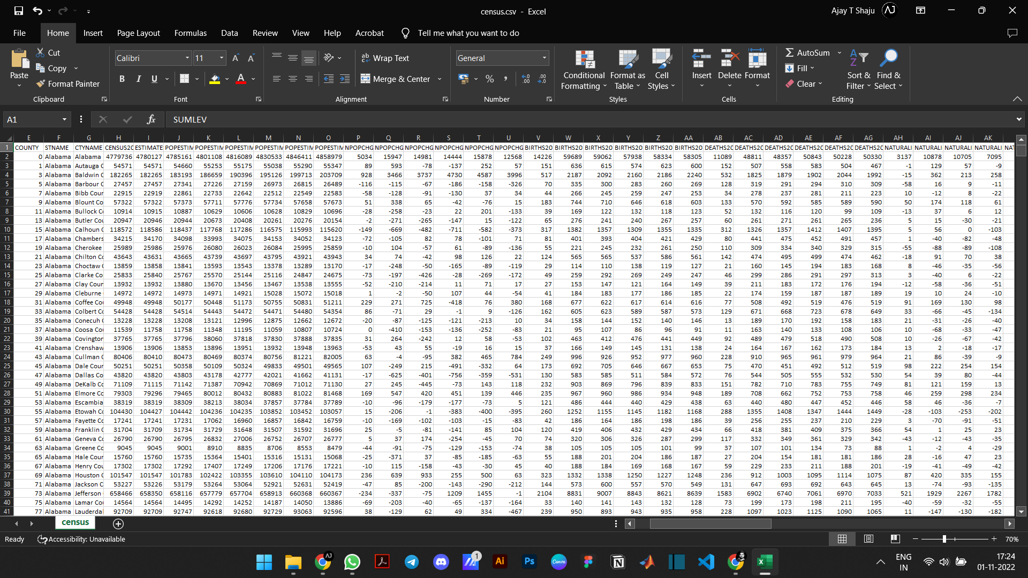
BIG DATA

Slide 30
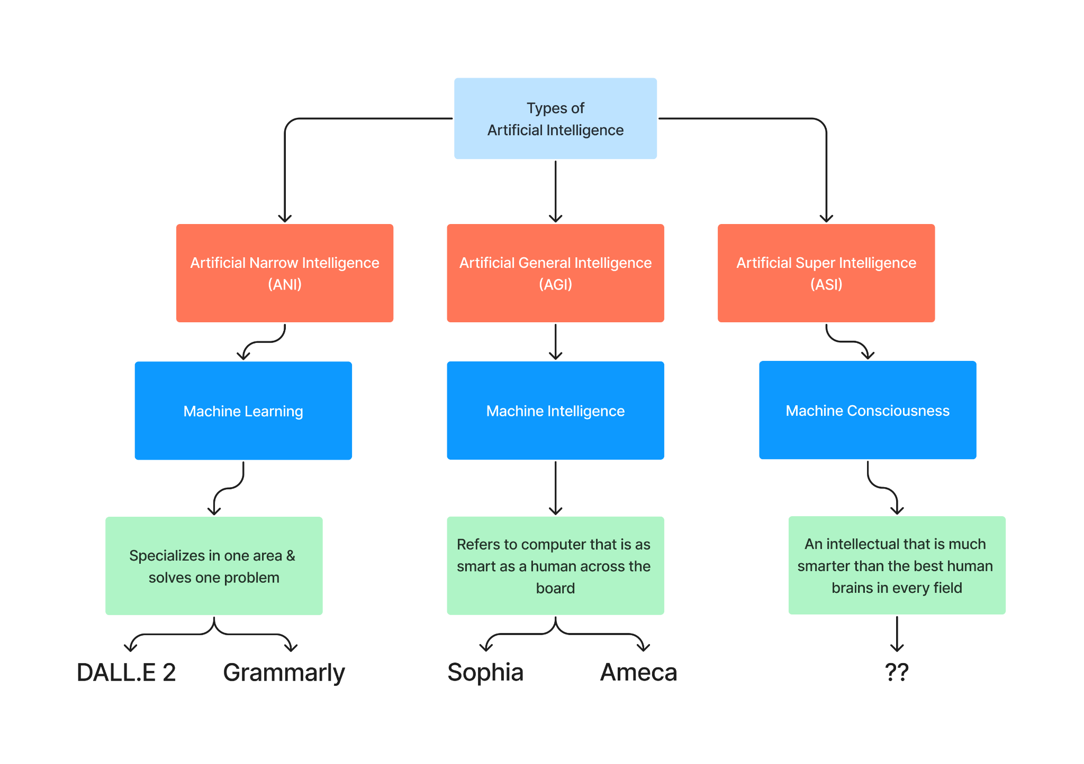

Slide 31
